Slide 1
Capstone Overview
Christopher I. Macintosh, PhD, RN
Notes:
Hello everyone
My name is Chris Macintosh. I help teach the capstone courses.
I wanted to give you an overview of this course and what we’ll be working on this semester.
[Next slide]

Slide 2
Capstone
Graduate students are expected to complete a final project that demonstrates a synthesis of clinical and didactic learning and demonstrates achievement of the objectives of graduate education. The student should work with their Specialty Track Director to select an appropriate project topic for their area of study and career goals. Master of Nursing capstone project includes an oral presentation and manuscript. The final manuscript for the course is considered the final examination that covers breadth and integration of material in the field.
Graduate students are expected to complete a final project that demonstrates a synthesis of clinical and didactic learning and demonstrates achievement of the objectives of graduate education. The student should work with their Specialty Track Director to select an appropriate project topic for their area of study and career goals. Master of Nursing capstone project includes an oral presentation and manuscript. The final manuscript for the course is considered the final examination that covers breadth and integration of material in the field.
(University of Utah College of Nursing, 2022, p. 13)
Notes:
This information about capstone comes from the Master’s Policy and Progression Manual.
[Read the text.]
[click]
You’ll notice I’ve highlighted some parts in red.
Capstone consists of a final project, an oral presentation, and a manuscript.
[Next slide]

Slide 3

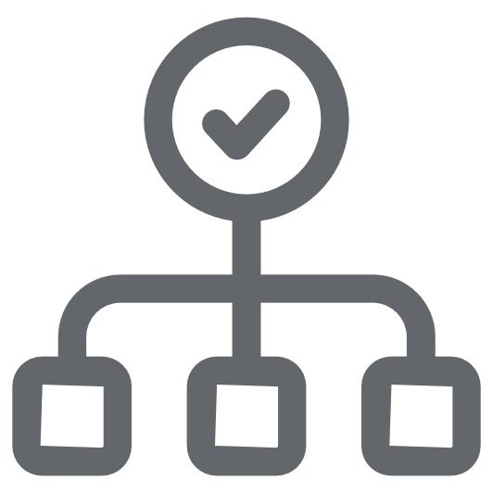


Proposal
Project
Manuscript
Presentation
Notes:
I’m going to reorder those a bit.
You need to understand your project before you can start writing your manuscript.
What you present will also be based on your project and the information you assemble as you write your manuscript.
We’re going to add one important step before you can start working on your project.
[click]
A project proposal.
[Next slide]

Slide 4
NURS 6880 Capstone I (fall)
Proposal
Project
Manuscript
Presentation
NURS 6881 Capstone II (spring)
Notes:
[click]
All these steps will be completed over two semesters.
In the fall you will work on creating your project proposal and outlining the main activities of your project.
In the spring you will complete the bulk of the work on your project, write your project manuscript, and deliver your oral presentation.
[Next slide]

Slide 5
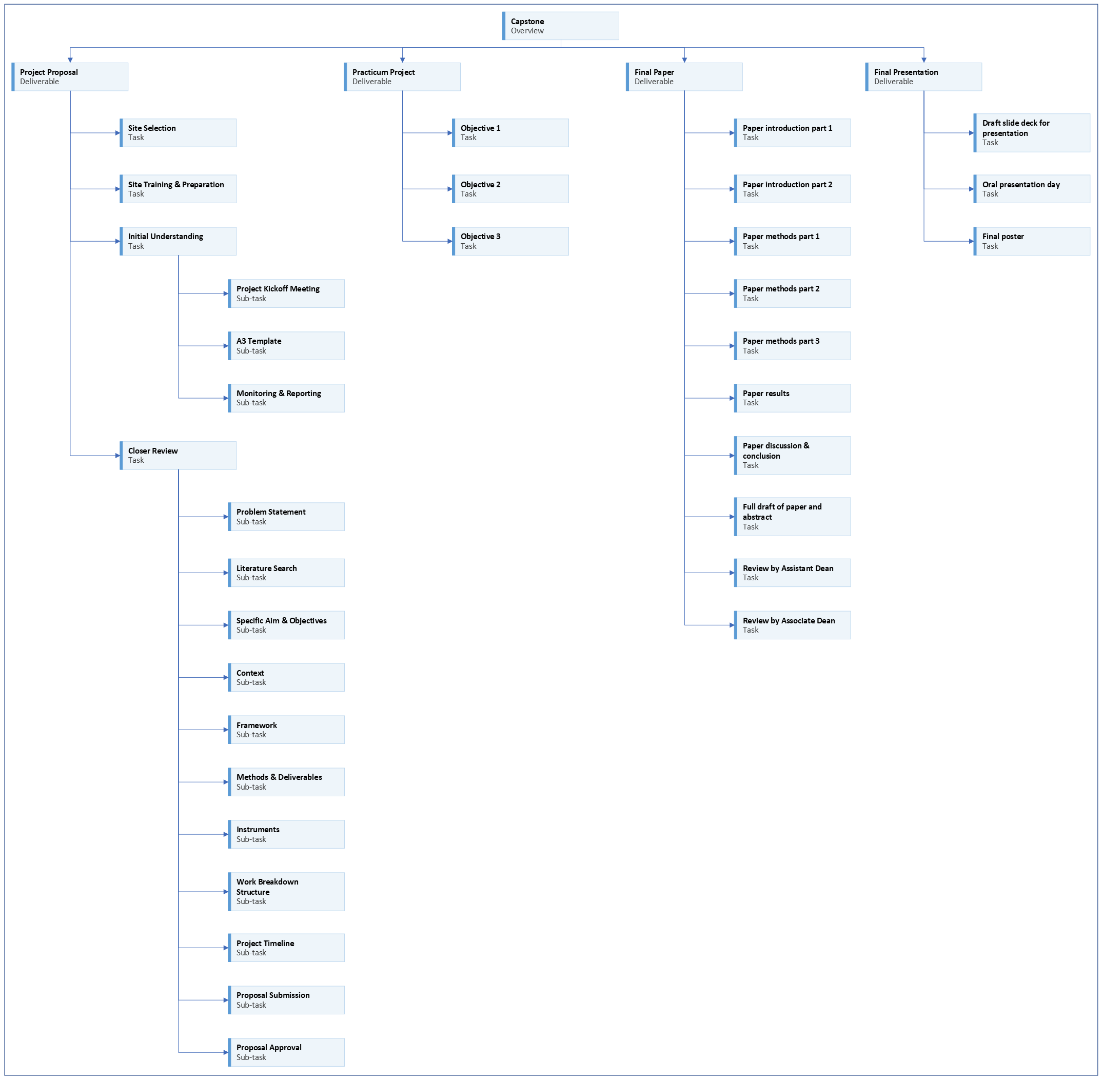
Notes:
This work breakdown structure diagram (aka WBS diagram) outlines many of the steps you will complete over the course of the next two semesters.
(You will learn what a work breakdown structure diagram is and how to create one this semester.)
A lot of the steps for you to complete your capstone have been planned for you.
[click] Including the steps and timing for working on your project proposal,
[click] writing your manuscript,
[click] and preparing your presentation.
[Click for last box.]
The main part you will need to work on is planning the steps and timing of your actual project.
[Next slide]

Slide 6
Proposal
Project
NURS 6880 Capstone I (fall)
Manuscript
Presentation
NURS 6880 Capstone II (spring)
Notes:
We will not need to discuss specifics about your manuscript and presentation until next semester.
[click]
We will focus on your project proposal and outlining the steps and timing of your project this semester.
[Next slide]

Slide 7
Notes:
Let’s look a little more closely at some of your first steps to get started this semester.
[Next slide]

Slide 8
Notes:
[click]
Before anything else can happen, we need to make sure everyone gets matched up with a practicum site and a site preceptor.
[click]
If your site has any mandatory trainings for students, those need to be completed before much else can be done.
[Next slide]

Slide 9

More to come . . .
Notes:
That’s all we’ll do in this video.
There is more to come.
[next slide]

Slide 10
References
University of Utah College of Nursing. (2022). Master's of science nursing program policy and progression manual 2022-2023. University of Utah College of Nursing. https://nursing.utah.edu/documents/masters-policy-and-progression20222023final
Notes:
This was the only reference.

